Slide 1
DevOps Lab
Varun khare
M.SC. STATISTISCS, M.TECH. CSE ( NIT JAIPUR )

Slide 2
Introduction
Gradle is a build automation tool used to compile, test, and package code in software projects.
It is widely used for Java, Kotlin, Android, and other languages. Think of it as a tool that helps developers manage dependencies, automate tasks, and build projects efficiently.

Slide 3
Gradle key features :
Incremental Builds – Gradle only rebuilds what has changed, making it faster than traditional build tools.
Dependency Management – Automatically downloads and manages project dependencies from repositories like Maven Central.
Multi-Language Support – Works with Java, Kotlin, Groovy, C++, Python, and more.
Customizable Build Scripts – Uses Groovy or Kotlin DSL for flexible and readable build configurations.
Gradle build scripts are simpler and more readable than Maven’s XML.

Slide 4
Commands
1. mkdir hellogradle
2. cd hellogradle
3. sudo apt update
4. sudo apt install openjdk-8-jdk
5. sudo update-alternatives --config java
6. gradle init --type java-application

Slide 5
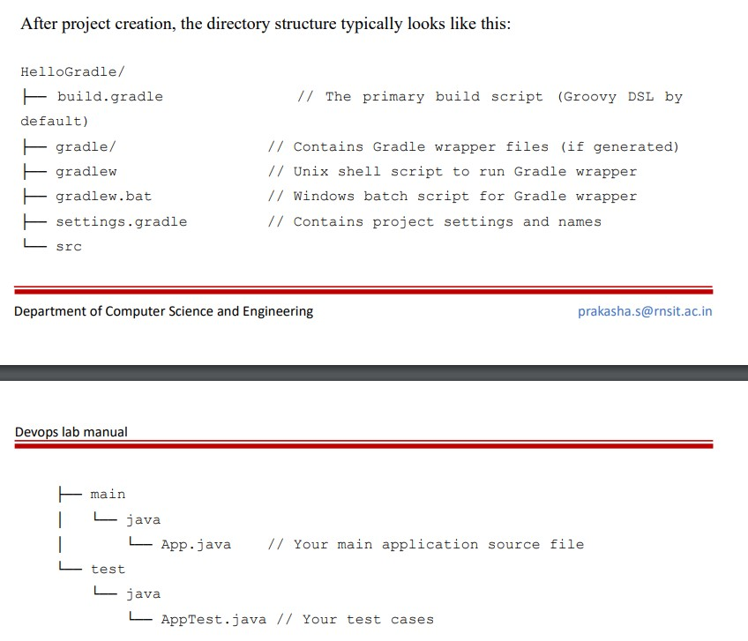
Contd..

Slide 6
Explanation of Components:
1. build.gradle:
This is the main build script written in Groovy (or Kotlin if you choose). It defines plugins, repositories, dependencies, and tasks.
2. settings.gradle:
A small script that defines the project’s name and, in multi-project builds, the included subprojects.
3. gradlew / gradlew.bat:
The Gradle wrapper scripts. They allow you to run Gradle without requiring a separate installation on every machine by automatically downloading the correct Gradle version.
4. src/main/java:
Contains your application’s source code.
5. src/test/java:
Contains your unit tests.

Slide 7
Understanding Gradle Build Scripts
A build script in Gradle is a programmatic file that instructs Gradle on how to build your project. It can be written in two main DSLs:
• Groovy DSL (build.gradle): The traditional and most common syntax.
• Kotlin DSL (build.gradle.kts): A statically-typed alternative that leverages Kotlin’s language features.

Slide 8
On next slide is an example of a basic build.gradle for a Java application using Groovy DSL:

Slide 9
For Groovy
plugins {
// Apply the Java plugin for compiling Java code
id 'java'
// Apply the application plugin to add support for building an
application
id 'application'
}
group = 'com.example'
version = '1.0'
repositories {
// Use Maven Central for resolving dependencies.
mavenCentral()
}
dependencies {
// Define your dependencies. For example, JUnit for testing:
testImplementation 'junit:junit:4.13.2'
}
application {
// Define the main class for the application.
mainClass = 'com.example.App'
}

Slide 10
For Groovy contd..
For running a task in groovy, edit build.gradle file and add the following :
task hello {
doLast {
println 'Hello, Gradle!'
}
}
7. gradle hello
Note : An alternative to Groovy for DSL in Gradle is Kotlin.

Slide 11
Commands
For running the whole project :
9. gradle build
10. gradle test
11. gradle run

